Slide 1
IMD WCY 2026
Juliet Mashabela

Slide 2
OUTLINE
Introduction
Methodology
Overall performance of SA
WCY 2026 Top 10 and Bottom 10
Trends of SA competitiveness factors
2026 competitiveness landscape of SA
Key attractiveness factors by business in SA
Improvements and declines
Strengths and Weaknesses of SA competitiveness

Slide 3
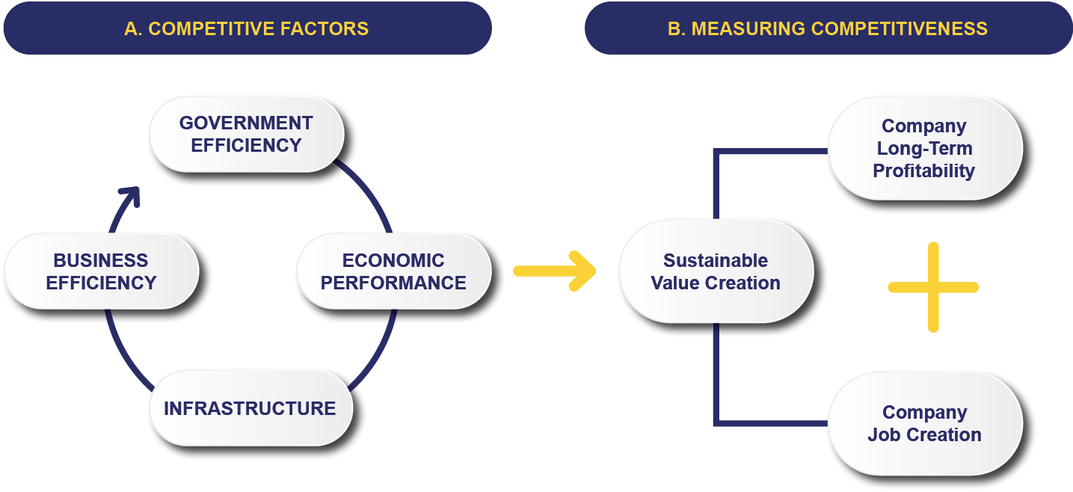
IMD COMPETITIVENESS
“the ability of a country to facilitate an environment in which enterprises can generate sustainable value,”
…sustainable value creation is the long-term capacity of enterprises to remain profitable, create fulfilling jobs, while minimizing the environmental impact of their activities.
3

Slide 4
IMD WCY
World Competitiveness Yearbook (WCY)
  An annual publication that compares the competitiveness of 70 countries since 1989
The Institute for Management Development (IMD) WCY
Published by the IMD based in Switzerland
Institute for Management Development (IMD) Partner Institutes. Productivity SA is the Partner Institute
Key objective of the WCY publication
  Assessment of countries’ global competitiveness

Slide 5
IMD WCY Methodology
The report is based on
Statistical data obtained from international and national sources such as World Bank, Stats SA, SARB, etc.
Perception (qualitative) survey obtained through the Executive Opinion Survey (EOS) completed by business leaders in the private sector
Perception (qualitative) survey complements statistical data
Quantify issues that are not easily measurable (e.g. management practices, labour relations, etc.)
WCY 2026 comprises
2025 statistical data and 2026 opinion survey
Opinion survey runs from January to March 2026

Slide 6
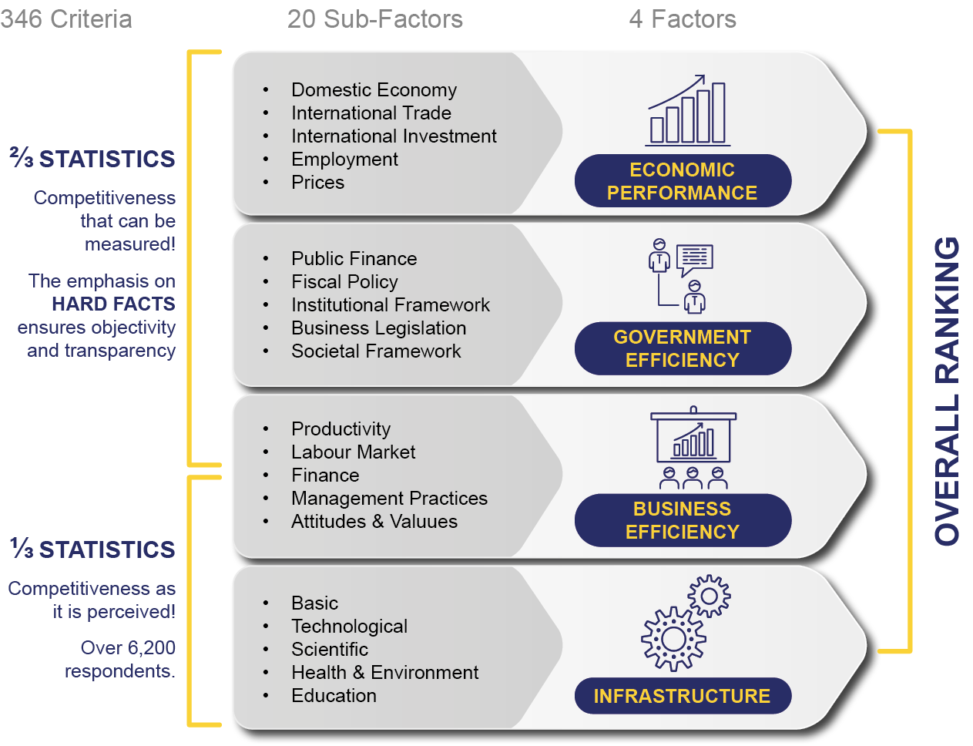
IMD WCY Methodology

Slide 7
IMD WCY Results
South Africa ranked 54th out of 70th countries
Improvement from 64th position in 2025
Comparator countries, between 2025 and 2026, Brazil (58th to 65th ),
India (41st to 44th) & China (16th to 12th)
Botswana (59th to 66th), Nigeria (67th to 68th) ,Ghana (61st to 64th ), Kenya (56th to 55th ) and Namibia (68th to 69th )
Vietnam (27th ) is new entrant in the 2026 rankings
Top 5 nations, between 2025 and 2026
Singapore (2nd to 1st ), Hong Kong (3rd to 2nd ), Switzerland (1st to 3rd ) , Taiwan (6th to 4th) and UAE (5th ),

Slide 8
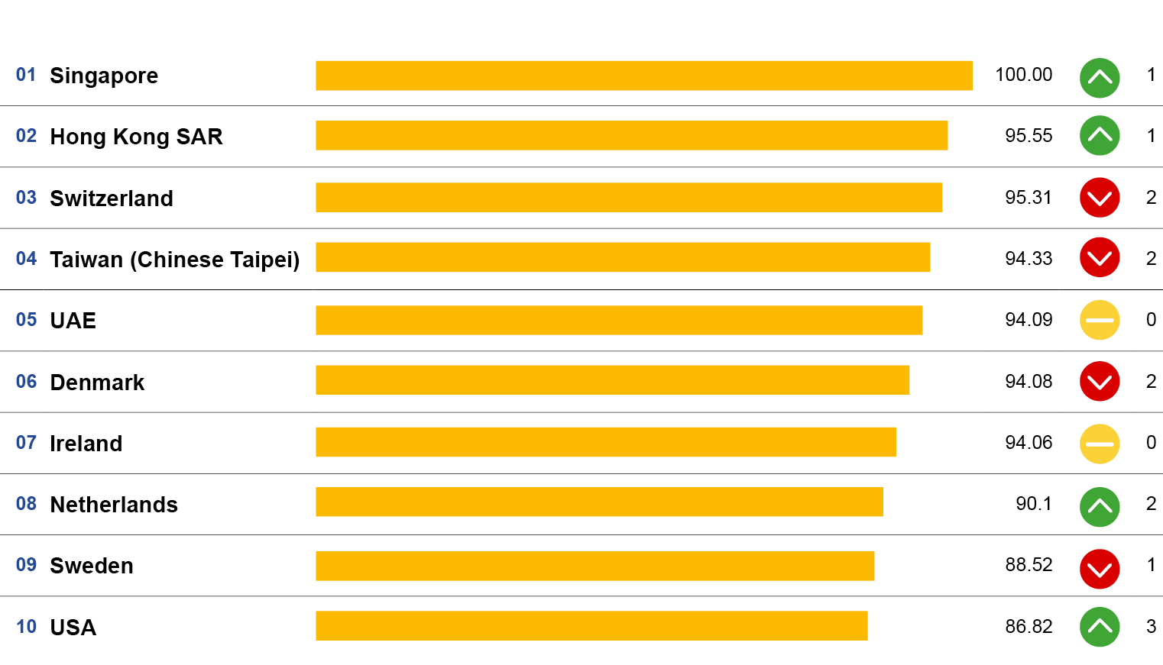
Top 10 Competitiveness Countries

Slide 9
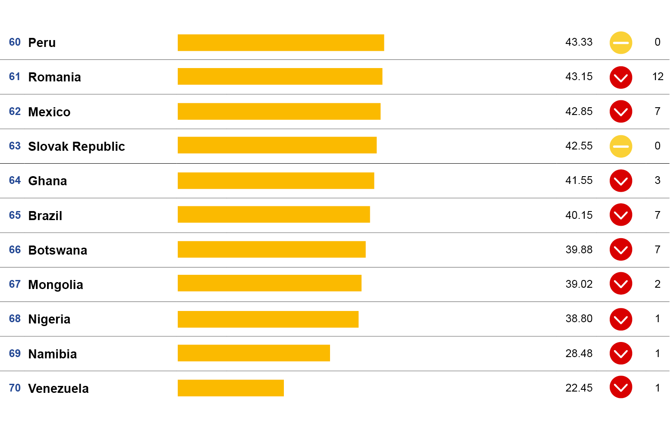
Bottom 10 Competitiveness Countries

Slide 10
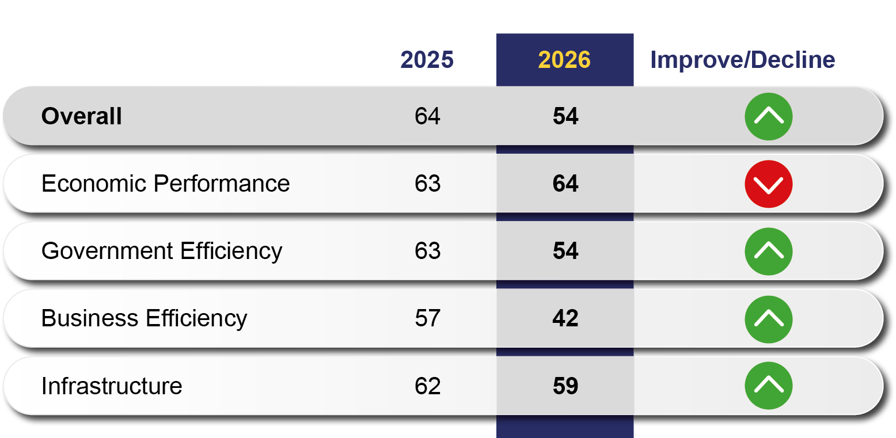
World Competitiveness Scoreboard: Overall ranking

Slide 11
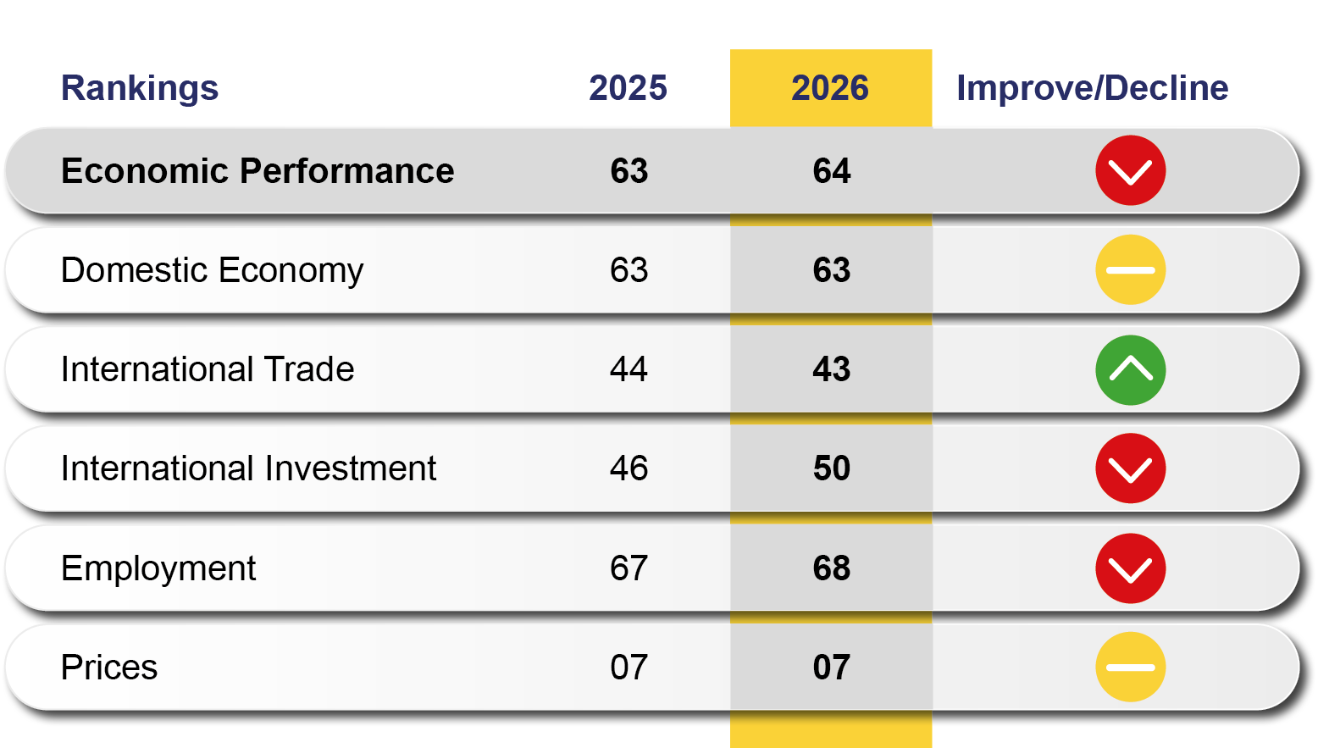
Competitiveness factors: Economic Performance

Slide 12
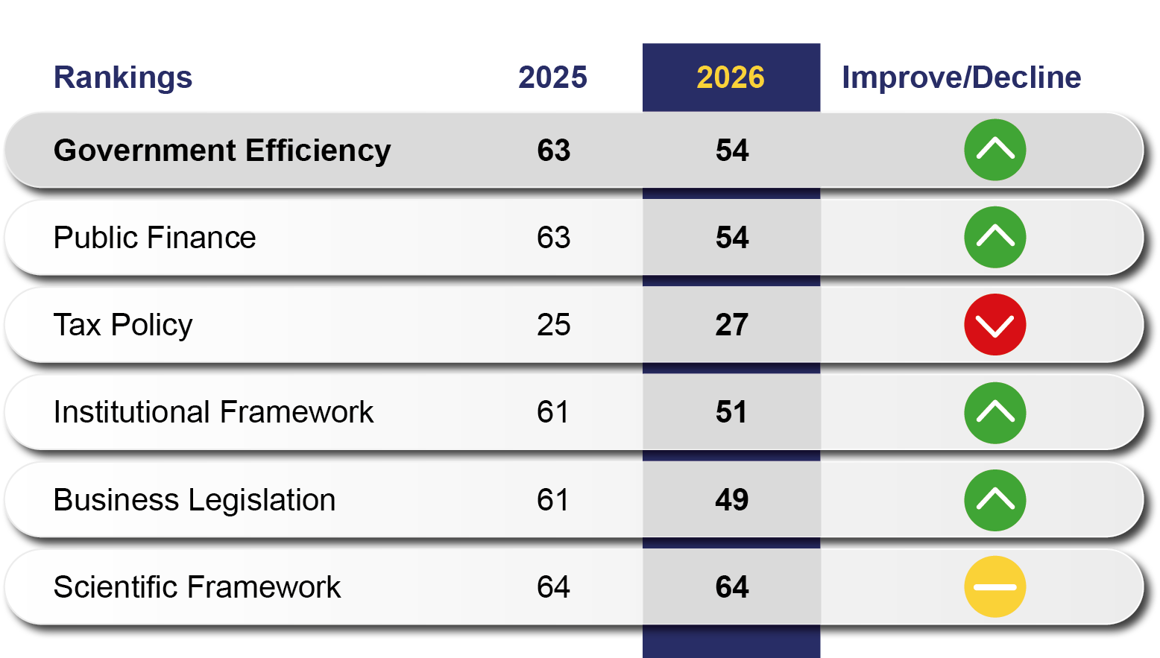
Competitiveness factors: Government Efficiency

Slide 13
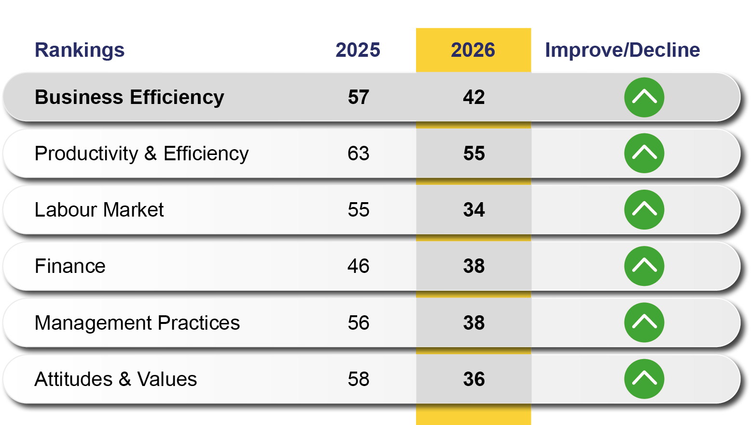
Competitiveness factors: Government Efficiency

Slide 14
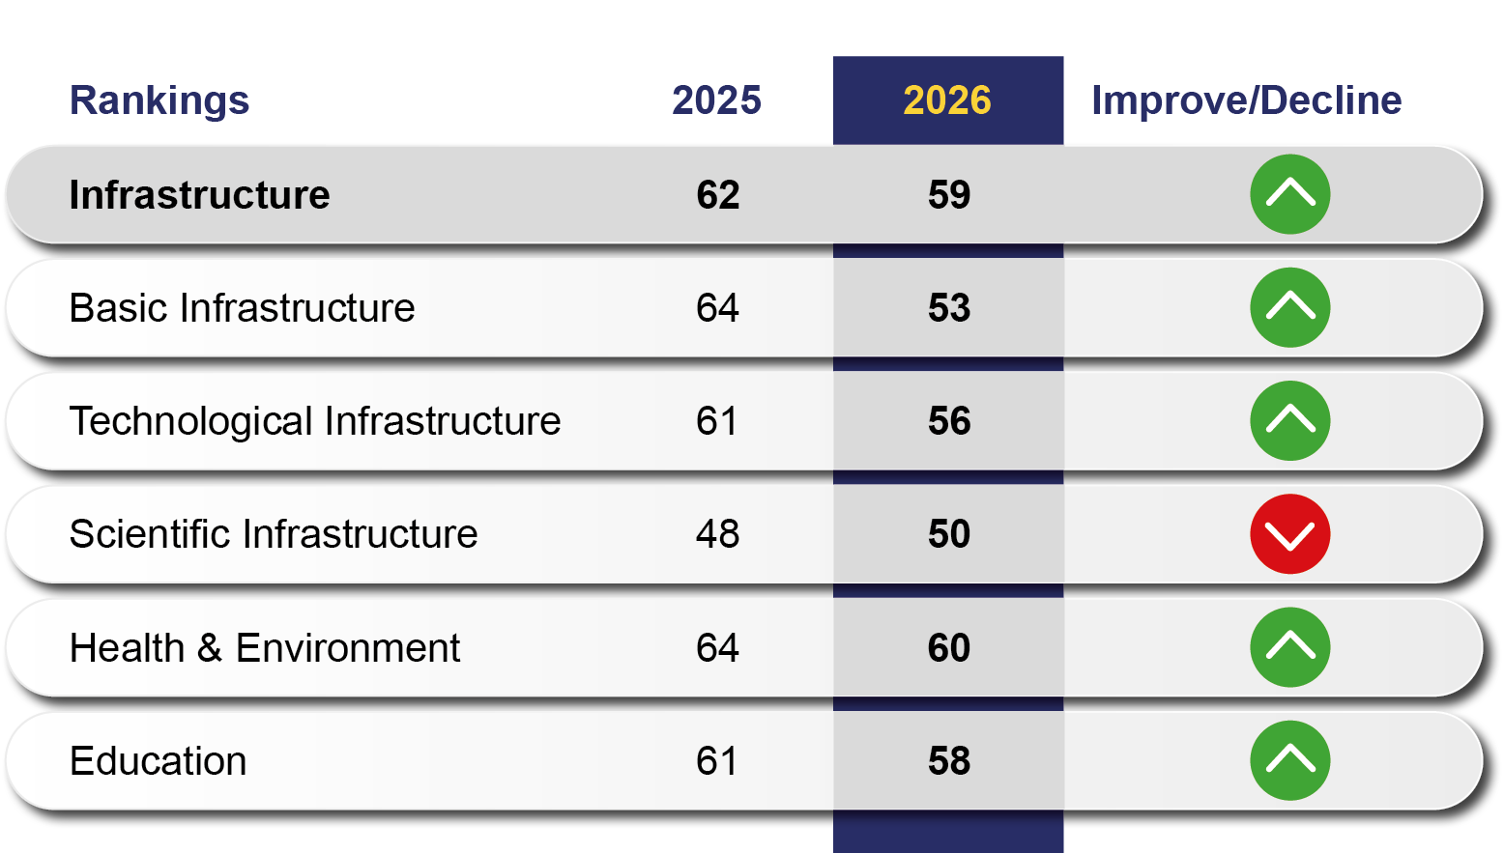
Competitiveness factors: Infrastructure

Slide 15
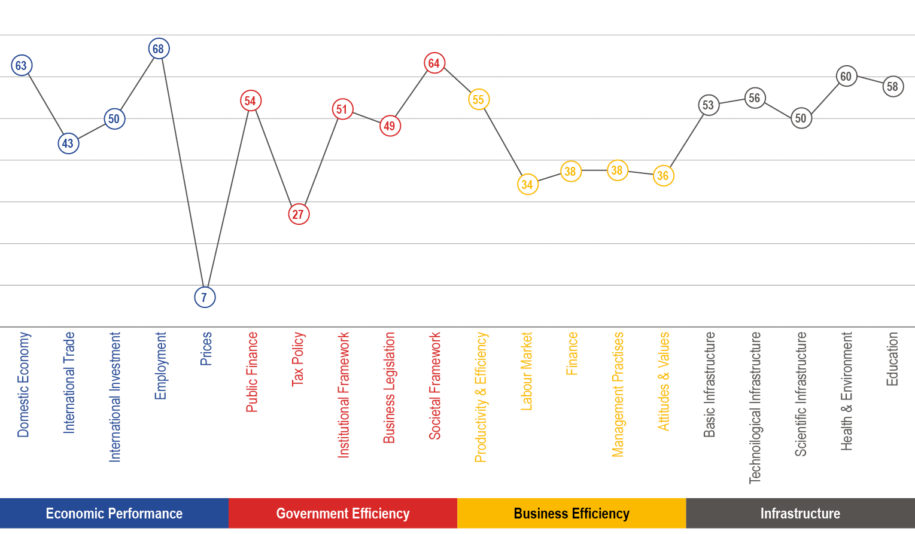
South Africa’s Competitive Landscape

Slide 16
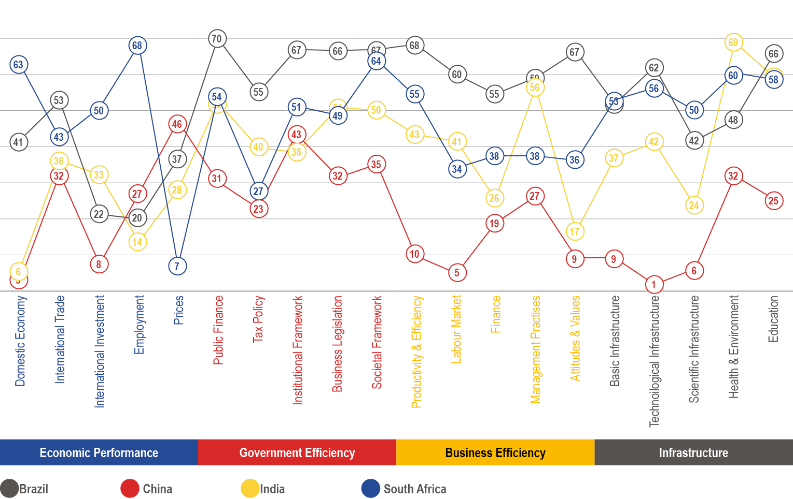
BRICS (except Russia)

Slide 17
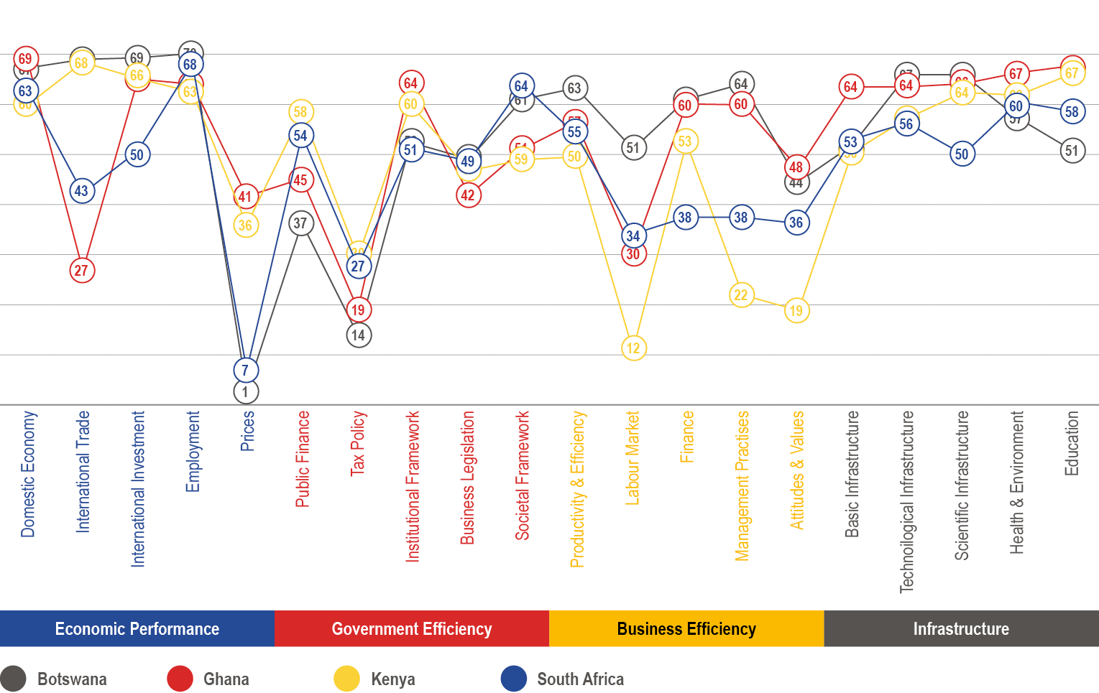
BRICS (except Russia)

Slide 18
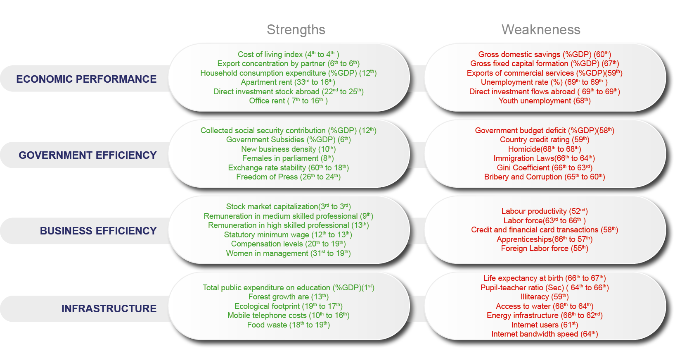
Strengths and Weaknesses

Slide 19
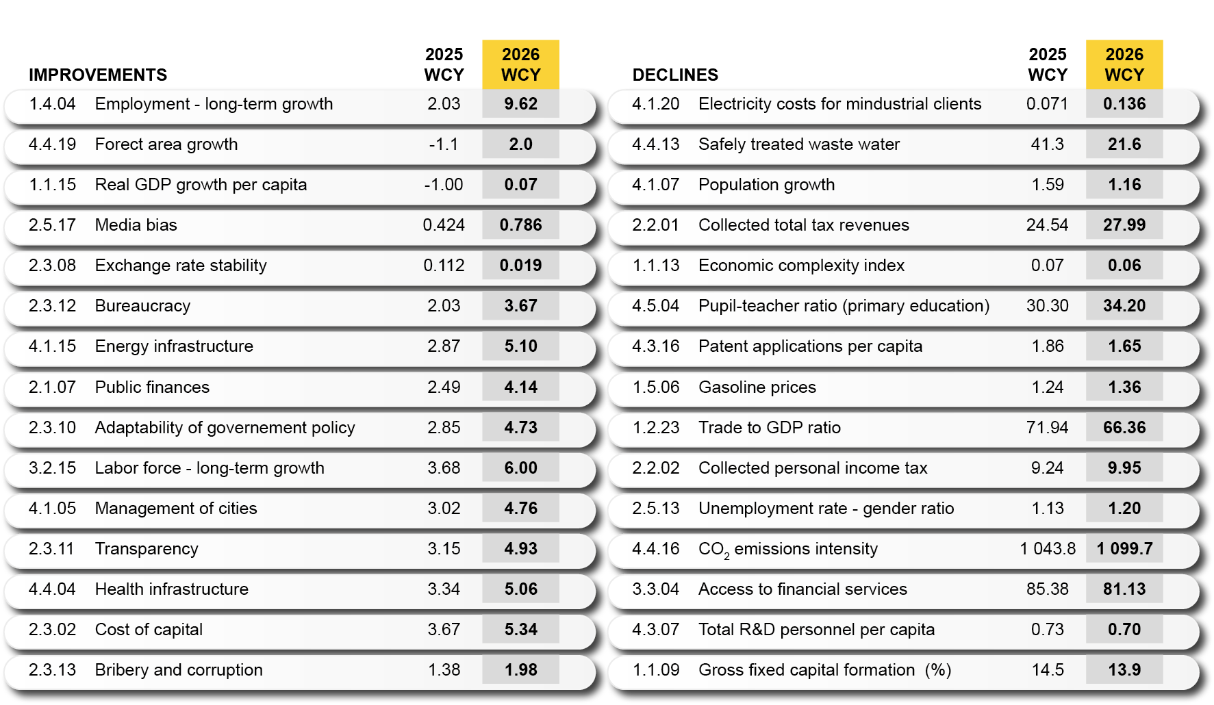
Improvements and Declines
The criteria below highlight the 15 biggest improvements and the 15 biggest declines in the overall performance of the economy. They are determined by the largest percentage changes in the value of each criterion from one yearbook to the next.

Slide 20
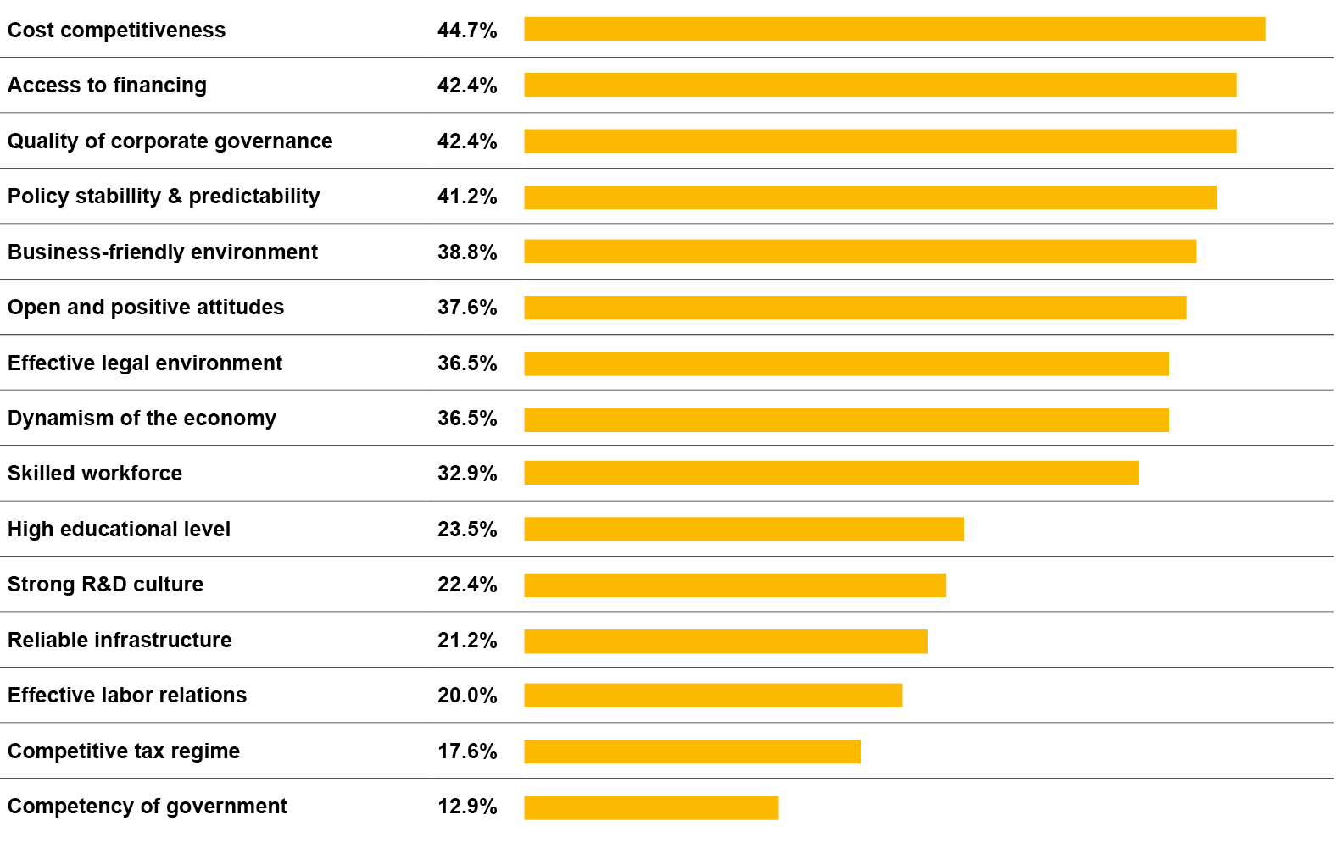
Key Attractiveness Indicators
From a list of 15 indicators, respondents of the Executive Opinion Survey were asked to select 5 that they perceived as the key attractiveness factors of their economy. The chart shows the percentage of responses per indicator from the highest number of responses to the lowest.

Slide 21
THANK YOU

